Slide 1
TikTok Tech Jam 2025
Problem Statement: https://bytedance.sg.larkoffice.com/docx/E6bhdCMUqojrxsxOFn5lFVdMgkc
Recording: https://bytedance.sg.larkoffice.com/minutes/obsgjn86367865561wr9fkt5

Slide 2
Objective
Design and implement an ML-based system to evaluate the quality and relevancy of Google location reviews
The system should:
Gauge review quality: Detect spam, advertisements, irrelevant content, and rants from users who have likely never visited the location.
Assess relevancy: Determine whether the content of a review is genuinely related to the location being reviewed.
Enforce policies: Automatically flag or filter out reviews that violate the following example policies:
No advertisements or promotional content.
No irrelevant content (e.g., reviews about unrelated topics).
No rants or complaints from users who have not visited the place (can be inferred from content, metadata, or other signals).

Slide 3
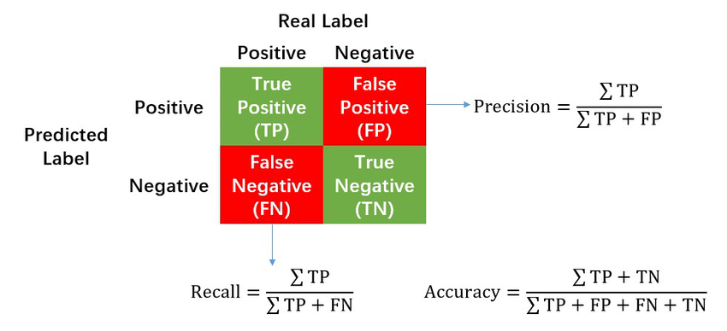
Evaluation Criteria
Precision - The ability of a model to identify only the relevant data points
Recall - The ability of a model to find all the relevant data points
F1 Score - Single score that balances both metrics ((2*Precision * Recall)/Precision+Recall))

Slide 4
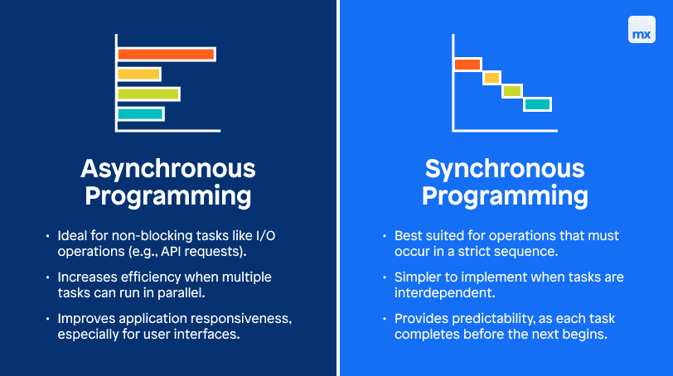
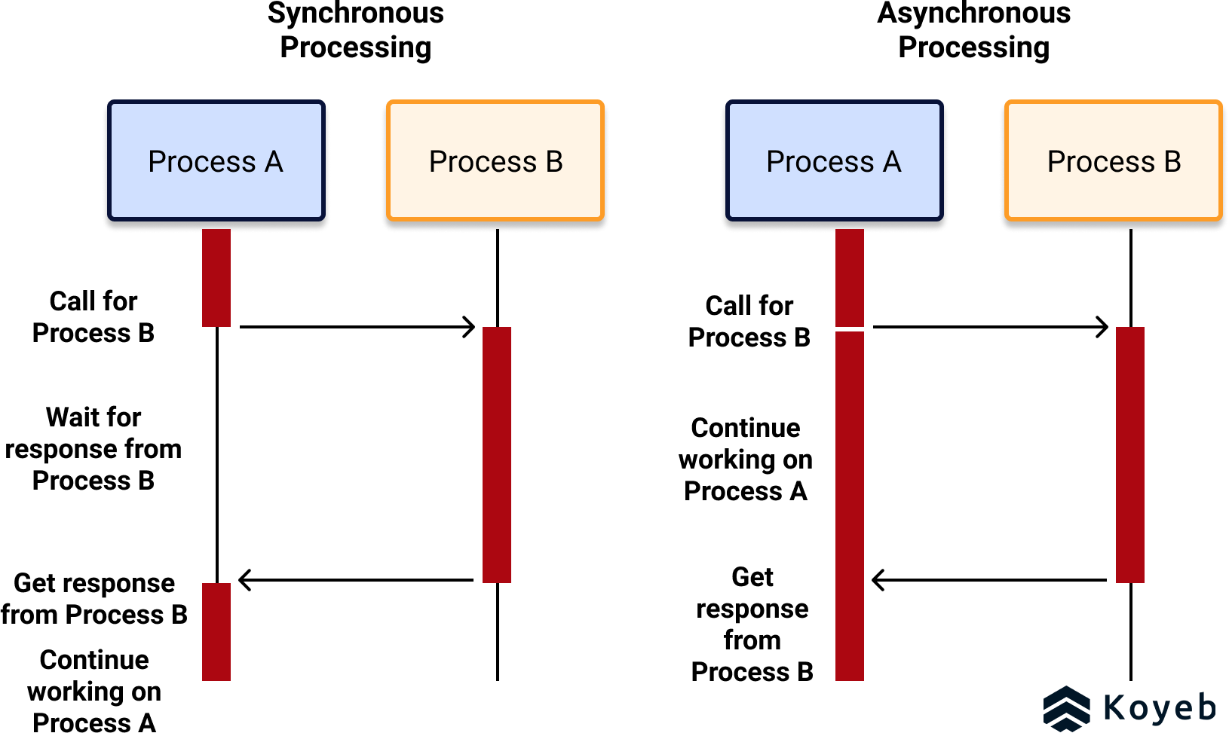
Sync vs Asycn
Notes:
# Sync vs Async
**Synchronous** executes tasks sequentially, blocking the next operation until the current one completes.
**Asynchronous** allows multiple tasks to run concurrently without waiting.

Slide 5
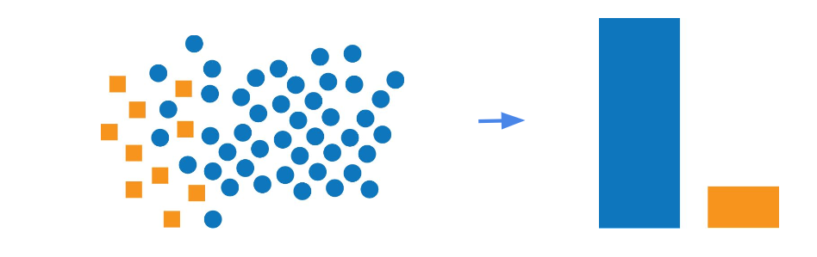
Imbalance Data Problem
Imbalanced data is a machine learning problem where one class has significantly more examples than others, causing models to become biased toward the majority class and perform poorly on the minority class.
In this case, if I trained a model based on this pseudo-labeled data, the newly trained model could just try it's luck and give "Legitimate" EVERYTIME. And it'll get it right most of the time (***/1100 correct).
Since it is a really good score no?

Slide 6
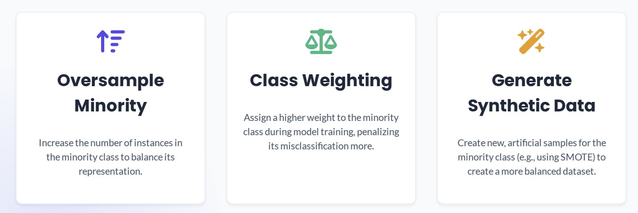
Dealing with Imbalance Data
Oversample Minority Classes
Class Weight
Generate Synthetic Data

